Slide 1
Compiler Construction
Intermediate Code Generation

Slide 2
Intermediate Code Generation (Chapter 8)

Slide 3
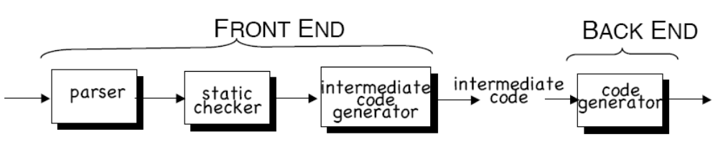
Intermediate code
INTERMEDIATE CODE is often the link between the compiler’s front end and back end.
Building compilers this way makes it easy to retarget code to a new architecture or do machine-independent optimization.

Slide 4
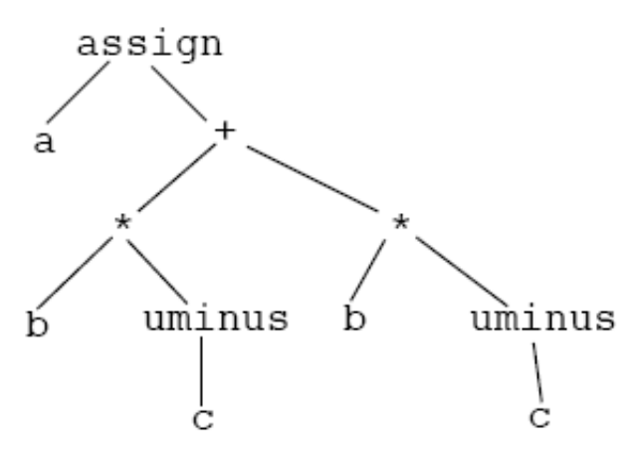
Intermediate representations
One possibility is the SYNTAX TREE:
Equivalently, we can use POSTFIX:
a b c uminus * b c uminus * + assign
(postfix is convenient because it can
run on an abstract STACK MACHINE)

Slide 5
Example syntax tree generation
Production Semantic Rule
S -> id := E S.nptr := mknode( ‘assign’, mkleaf( id, id.place ), E.nptr )
E -> E1 + E2 E.nptr := mknode( ‘+’, E1.nptr, E2.nptr )
E -> E1 * E2 E.nptr := mknode( ‘*’, E1.nptr, E2.nptr )
E -> - E1 E.nptr := mknode( ‘uminus’, E1.nptr )
E -> ( E1 ) E.nptr := E1.nptr
E -> id E.nptr := mkleaf( id, id.place )

Slide 6
Three-address code
A more common representation is THREE-ADDRESS CODE (3AC)
3AC is close to assembly language, making machine code generation easier.
3AC has statements of the form
  x := y op z
To get an expression like x + y * z, we introduce TEMPORARIES:
  t1 := y * z
  t2 := x + t1
3AC is easy to generate from syntax trees. We associate a temporary with each interior tree node.

Slide 7
Types of 3AC statements
Assignment statements of the form x := y op z, where op is a binary arithmetic or logical operation.
Assignement statements of the form x := op Y, where op is a unary operator, such as unary minus, logical negation
Copy statements of the form x := y, which assigns the value of y to x.
Unconditional statements goto L, which means the statement with label L is the next to be executed.
Conditional jumps, such as if x relop y goto L, where relop is a relational operator (<, =, >=, etc) and L is a label. (If the condition x relop y is true, the statement with label L will be executed next.)

Slide 8
Types of 3AC statements
Statements param x and call p, n for procedure calls, and return y, where y represents the (optional) returned value. The typical usage: p(x1, …, xn)
  param x1
  param x2
  …
  param xn
  call p, n
Index assignments of the form x := y[i] and x[i] := y. The first sets x to the value in the location i memory units beyond location y. The second sets the content of the location i unit beyond x to the value of y.
Address and pointer assignments:
  x := &y
  x := *y
  *x := y

Slide 9
Syntax-directed generation of 3AC
Idea: expressions get two attributes:
  E.place: a name to hold the value of E at runtime
    id.place is just the lexeme for the id
  E.code: the sequence of 3AC statements implementing E
We associate temporary names for interior nodes of the syntax tree.
  The function newtemp() returns a fresh temporary name on each invocation

Slide 10
Syntax-directed translation
For ASSIGNMENT statements and expressions, we can use this SDD:
  Production Semantic Rules
  S -> id := E S.code := E.code || gen( id.place ‘:=‘ E.place )
  E -> E1 + E2 E.place := newtemp();
  E.code := E1.code || E2.code ||
  gen( E.place ‘:=‘ E1.place ‘+’ E2.place )
  E -> E1 * E2 E.place := newtemp();
  E.code := E1.code || E2.code ||
  gen( E.place ‘:=‘ E1.place ‘*’ E2.place )
  E -> - E1 E.place := newtemp();
  E.code := E1.code || gen( E.place ‘:=‘ ‘uminus’
  E1.place )
  E -> ( E1 ) E.place := E1.place; E.code := E1.code
  E -> id E.place := id.place; E.code := ‘’

Slide 11
Example
Parse and evaluate the SDD for
a := b + c * d

Slide 12
Adding flow-of-control statements
For WHILE-DO statements and expressions, we can add:
  Production Semantic Rules
  S -> while E do S1 S.begin := newlabel();
  S.after := newlabel();
  S.code := gen( S.begin ‘:’ ) || E.code ||
  gen( ‘if’ E.place ‘=‘ ‘0’ ‘goto’ S.after ) ||
  S1.code ||
  gen( ‘goto’ S.begin ) ||
  gen( S.after ‘:’ )
Try this one with: while E do x := x + y

Slide 13
3AC implementation
How can we represent 3AC in the computer?
The main representation is QUADRUPLES (structs containing 4 fields)
  OP: the operator
  ARG1: the first operand
  ARG2: the second operand
  RESULT: the destination

Slide 14
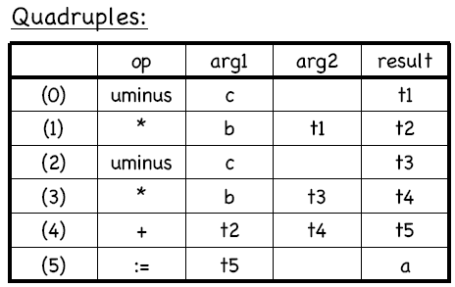
3AC implementation
Code:
a := b * -c + b * -c
3AC:
t1 := -c
t2 := b * t1
t3 := -c
t4 := b * t3
t5 := t2 + t4
a := t5

Slide 15
Declarations
When we encounter declarations, we need to lay out storage for the declared variables.
For every local name in a procedure, we create a ST(Symbol Table) entry containing:
  The type of the name
  How much storage the name requires
  A relative offset from the beginning of the static data area or beginning of the activation record.
For intermediate code generation, we try not to worry about machine-specific issues like word alignment.

Slide 16
Declarations
To keep track of the current offset into the static data area or the AR, the compiler maintains a global variable, OFFSET.
OFFSET is initialized to 0 when we begin compiling.
After each declaration, OFFSET is incremented by the size of the declared variable.

Slide 17
Translation scheme for decls in a procedure
  P -> D { offset := 0 }
  D -> D ; D
  D -> id : T { enter( id.name, T.type, offset );
  offset := offset + T.width }
  T -> integer { T.type := integer; T.width := 4 }
  T -> real { T.type := real; T.width := 8 }
  T -> array [ num ] of T1 { T.type := array( num.val, T1.type );
  T.width := num.val * T1.width }
  T -> ^ T1 { T.type := pointer( T1.type );
  T.width := 4 }
Try it for x : integer ; y : array[10] of real ; z : ^real

Slide 18
Keeping track of scope
When nested procedures or blocks are entered, we need to suspend processing declarations in the enclosing scope.
Let’s change the grammar:
  P -> D
  D -> D ; D | id : T | proc id ; D ; S

Slide 19
Keeping track of scope
Suppose we have a separate ST(Symbol table) for each procedure.
When we enter a procedure declaration, we create a new ST.
The new ST points back to the ST of the enclosing procedure.
The name of the procedure is a local for the enclosing procedure.
Example: Fig. 8.12 in the text

Slide 20
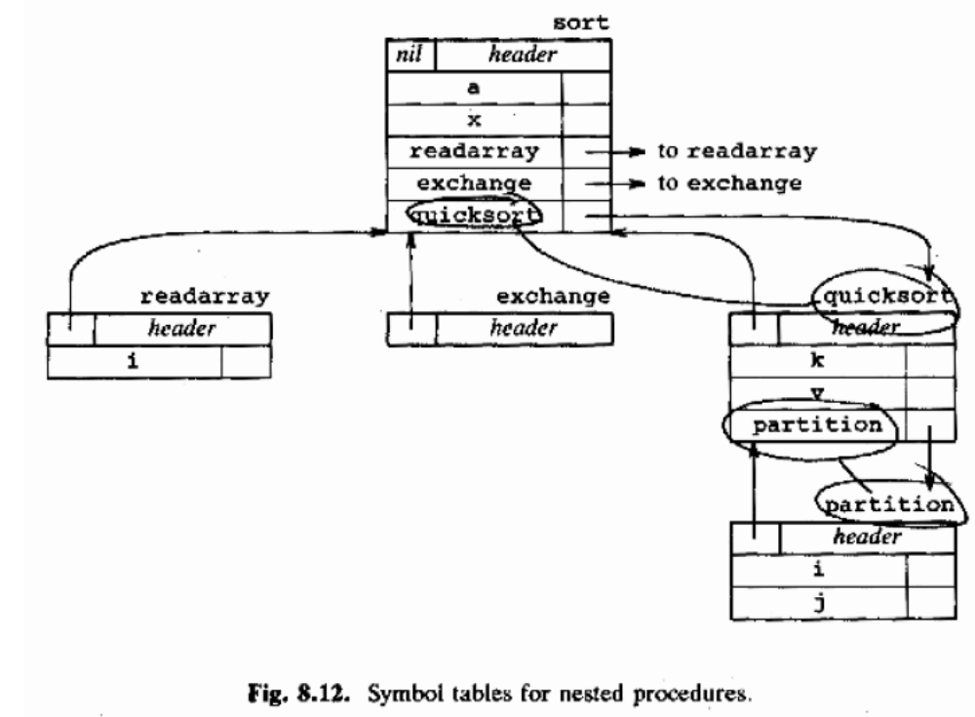

Slide 21
Operations supporting nested STs
mktable(previous) creates a new symbol table pointing to previous, and returns a pointer to the new table.
enter(table,name,type,offset) creates a new entry for name in a symbol table with the given type and offset.
addwidth(table,width) records the width of ALL the entries in table.
enterproc(table,name,newtable) creates a new entry for procedure name in ST table, and links it to newtable.

Slide 22
Translation scheme for nested procedures
P -> M D { addwidth(top(tblptr), top(offset));
pop(tblptr); pop(offset) }
M -> ε { t := mktable(nil);
push(t,tblptr); push(0,offset); }
D -> D1 ; D2
D -> proc id ; N D1 ; S { t := top(tblptr);
addwidth(t,top(offset));
pop(tblptr); pop(offset);
enterproc(top(tblptr),id.name,t) }
D -> id : T { enter(top(tblptr),id.name,T.type,top(offset));
top(offset) := top(offset)+T.width }
N -> ε { t := mktable( top( tblptr ));
push(t,tblptr); push(0,offset) }
Stacks

Slide 23
Records
Records take a little more work.
Each record type also needs its own symbol table:
  T -> record L D end { T.type := record(top(tblptr));
  T.width := top(offset);
  pop(tblptr); pop(offset); }
  L -> ε { t := mktable(nil);
  push(t,tblptr); push(0,offset); }

Slide 24
Adding ST lookups to assignments
Let’s attach our assignment grammar to the procedure
declarations grammar.
  S -> id := E { p := lookup(id.name);
  if p != nil then emit( p ‘:=‘ E.place ) else error }
  E -> E1 + E2 { E.place := newtemp();
  emit( E.place ‘:=‘ E1.place ‘+’ E2.place ) }
  E -> E1 * E2 { E.place := newtemp();
  emit( E.place ‘:=‘ E1.place ‘*’ E2.place ) }
  E -> - E1 { E.place := newtemp();
  emit( E.place ‘:=‘ ‘uminus’ E1.place ) }
  E -> ( E1 ) { E.place := E1.place }
  E -> id { p := lookup(id.name);
  if p != nil then E.place := p else error }
lookup() now starts with the table top(tblptr) and searches all enclosing scopes.
write to output file

Slide 25
Nested symbol table lookup
Try lookup(i) and lookup(v) while processing statements in procedure partition(), using the symbol tables of Figure 8.12.

Slide 26
Addressing array elements
If an array element has width w, then the ith element of array A begins at address
base + ( i - low ) * w
where base is the address of the first element of A.
We can rewrite the expression as
i * w + ( base - low * w )
The first term depends on i (a program variable)
The second term can be precomputed at compile time.

Slide 27
Two-dimensional arrays
In a 2D array, the offset of A[i1,i2] is
base + ( (i1-low1)*n2 + (i2-low2) ) * w
This can be rewritten as
((i1*n2)+i2)*w+(base-((low1*n2)+low2)*w)
Where the first term is dynamic and the second term is static (precomputable at compile time).
This generalizes to N dimensions.

Slide 28
Code generation for array references
We replace plain “id” as an expression with a nonterminal
S -> L := E
E -> E + E
E -> ( E )
E -> L
L -> Elist ]
L -> id
Elist -> Elist, E
Elist -> id [ E

Slide 29
Code generation for array references
a temp var
containing
a calculated
array offset
S -> L := E { if L.offset = null then
/* L is a simple id */
emit(L.place ‘:=‘ E.place);
else
emit(L.place ’[‘ L.offset ‘]’ ‘:=‘ E.place) }
E -> E + E { … (no change) }
E -> ( E ) { … (no change) }
E -> L { if L.offset = null then
/* L is a simple id */
E.place := L.place
else begin
E.place := newtemp;
emit( E.place ‘:=‘ L.place ‘[‘ L.offset ‘]’ )
end }

Slide 30
Code generation for array references
the static
part of the array
reference
L -> Elist ] { L.place := newtemp;
L.offset := newtemp;
emit(L.place ‘:=‘ c(Elist.array));
emit(L.offset ‘:=‘ Elist.place ‘*’
width(Elist.array)) }
L -> id { L.place := id.place; L.offset = null }
Elist -> Elist1, E { t := newtemp(); m := Elist1.ndim + 1;
emit(t ‘:=‘ Elist1.place ‘*’
limit( Elist1.array, m ));
emit(t ‘:=‘ t ‘+’ E.place );
Elist.array := Elist1.array;
Elist.place := t; Elist.ndim := m }
Elist -> id [ E { Elist.array := id.place;
Elist.place := E.place; Elist.ndim := 1 }

Slide 31
Example multidimensional array reference
Suppose A is a 10x20 array with the following details:
  low1 = 1 n1 = 10
  low2 = 1 n2 = 20
  w = 4
Try parsing and generating code for the assignment
x := A[y,z]
(generate the annotated parse tree and show the

Slide 32
Other topics in 3AC generation
The fun has only begun!
  Often we require type conversions (p 485)
  Boolean expressions need code generation too (p 488)
  Case statements are interesting (p 497)

